Slide 1
Modelling Patterns Review & Suggestions
Dr Linda Bird
16th August 2012

Slide 2
Modelling Layers
CLUSTER
ENTRY
SECTION
COMPOSITION
Add Implementation Purpose Context
Dispensed Medications GUI
Neonatal Blood Pressure in EHR
Current Medication List in EHR
Discharge Summary Doc or Message
Add Care Setting Context
G.P. Dispensed Medication Item
Home Blood Pressure
Outpatient Clinic Current Medication List
Inpatient Discharge Summary
Add Specialty Context
Paediatric Medication Item
Neonatal Blood Pressure
Nephrologist Medication List
Cardiology Discharge Summary
Add Use Case Context
Dispensed Medication Item
Standing Blood Pressure
Current Medication List
Medication Reconciliation Report
Clinical Models
Medication Item
Blood Pressure
Medication List
Discharge Summary
Modelling Patterns
Schedule,
Address,
Material
Observation,
Action
Clinical List
Event Summary,
Assessment
Reference Model

Slide 3
Modelling Patterns Review
openEHR
NHS LRA
SNOMED CT
results4Care DCMs
IMH CEMs
MOHH LIM
VA’s Discernables
EN13606 Association
HL7 v3 RIM

Slide 4
Modelling Patterns Types
Clinical Statement Types
Isosemantic model structure
key concept, qualifiers, modifiers
Clinical processes events links
History of Events
Order state machine and care flow mapping
Composition/Document
Clinical Model Patterns
Reference Range Set, Schedule, Material (Device, Medication), Score/Assessment Scale
Clinical Statement Types
Isosemantic model structure
key concept, qualifiers, modifiers
Clinical processes events links
History of Events
Order state machine and care flow mapping
Composition/Document
Clinical Model Patterns
Reference Range Set, Schedule, Material (Device, Medication), Score/Assessment Scale

Slide 5
NHS LRA Care Components Reference Model

Slide 6
NHS LRA – ELEMENT patterns

Slide 7
NHS LRA – ELEMENT Domain Models
Finding Observations
AllergyOrAdverseReactionEvent
AllergyOrAdverseReactionPropensity
DiagnosisName
GenericFindingObservation
GenericProblemAndIssue
RisksExpectationsOrGoals
Property Observations
BloodPressureObservation
BloodSugarObservation
BodyHeightObservation
BodySurfaceAreaObservation
BodyWeightObservation
DiastolicPressureObservation
GenericPropertyObservation
PulseRateObservation
General Activities
GenericAdmissionEvent
GenericDischargeEvent
GenericProcedure
SpecimenCollection
Material Activities
GenericSpecimen
MeasurementDevice
ProductOrSubstance
Investigation Activities
BloodPressureMeasurement
BodyHeightMeasurement
TemperatureMeasurement
Unbound Data
AdviceForPatient
CourseTiming
FutureEventTime
InterpretationRange

Slide 8
NHS LRA – ENTRY Domain Models
GenericClinicalNarrative
GenericAdmissionEvent
GenericFinding
HealthcareActionPlan
GenericProblemAndIssue
GenericProcedure
GenericProperty
MedicationReviewPlan
ProductOrSubstance
ProductOrSubstanceRelatedActivity
ProvisionOfInformationAndAdvice
RecommendationActivity
AllergyOrAdverseReactionEvent
GenericAdmissionProspect
AllergyOrAdverseReactionPropensity
GenericDischargeEvent
BloodPressure
BloodSugar
GenericTransfer
BodyHeight
GenericTransferProspect
BodySurfaceArea
RisksExpectationsAndGoals
BodyWeight
ProvisionOfAdviceAndInformation
Diagnosis
FluidIntakeRate
GenericAssessment
SubjectOfCareObservations
GenericInvestigation
PulseRate
Temperature
TreatmentDevice

Slide 9
NHS LRA – e.g. Temperature ENTRY

Slide 10
NHS LRA – e.g. Temperature ENTRY
Subject of Information (Participation)
Information Provider (Participation)
OtherParticipation (Participation)
TemperatureObservation (PropertyObservation)
TemperatureMeasurement (InvestigationActivity)
Text (UnboundDataElement)
UnboundGenericFinding (UnboundDataElement)
GenericFindingObservation (FindingObservation)

Slide 11
NHS LRA – e.g. TemperatureObservation ELEMENT

Slide 12
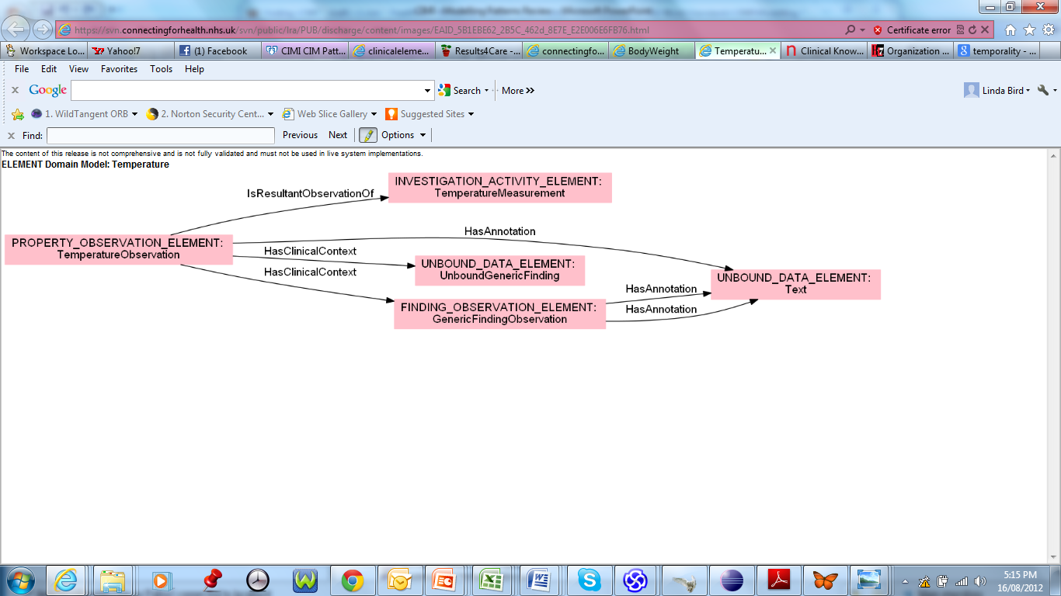
NHS LRA – e.g. TemperatureObservation ELEMENT (mindmap)

Slide 13
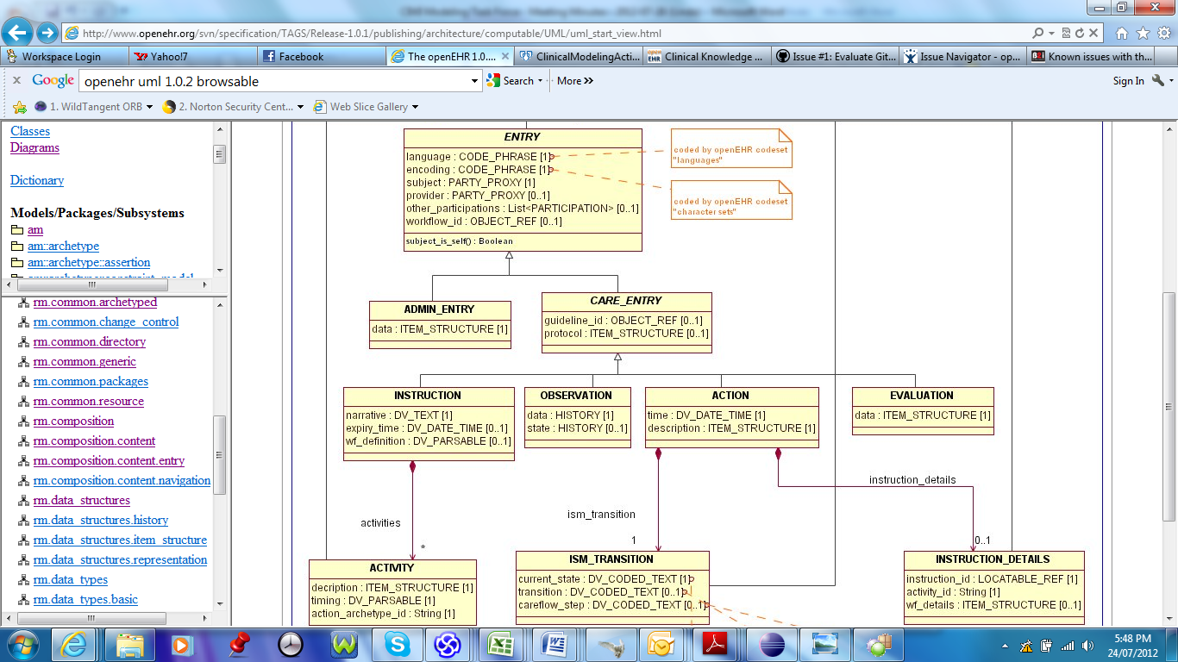
openEHR – ENTRY patterns

Slide 14
SNOMED CT
OBSERVABLE ENTITY
CLINICAL FINDING
Finding method: PROCEDURE
Interprets: PROCEDURE
Interprets: OBSERVABLE ENTITY
PROCEDURE
Has focus: CLINICAL FINDING

Slide 15
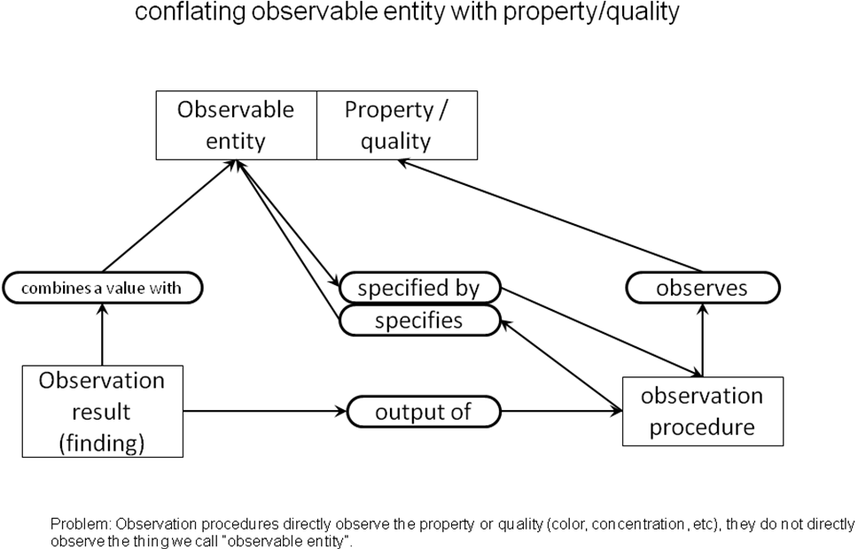
SNOMED CT – Observable (draft)

Slide 16
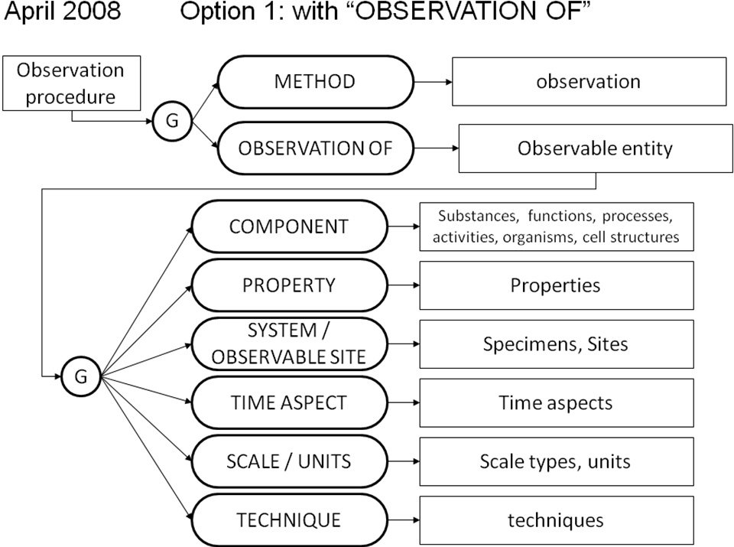
SNOMED CT – Observable (draft)

Slide 17
results4Care DCMs
Root concept
Data
Qualifier
State

Slide 18
IMH CEMs
Observed, StandardLabObs, Procedure, Order, Intolerance, Allergy, Adverse Reaction Summary, Admit/AdminDiagnosis
Key, Item, Qualifier, Modifier, Attribution

Slide 19
MOHH LIM
ENTRY
Observation Entry (Observable Name/Value)
Heart Rate/ Blood Pressure / Blood Glucose
Clinical Finding
Problem Diagnosis Entry
Adverse Reaction Entry
Alert Entry
Activity
Pharmacy Activity Entry
Pharmacy Order Entry
Pharmacy Dispense Entry
Pharmacy Administration Entry
Investigation Activity Entry
Investigation Order Entry
Investigation Result Entry
Procedure Entry (Reference Pattern)
CLUSTER
Pharmacy Item / Investigation Test Item

Slide 20
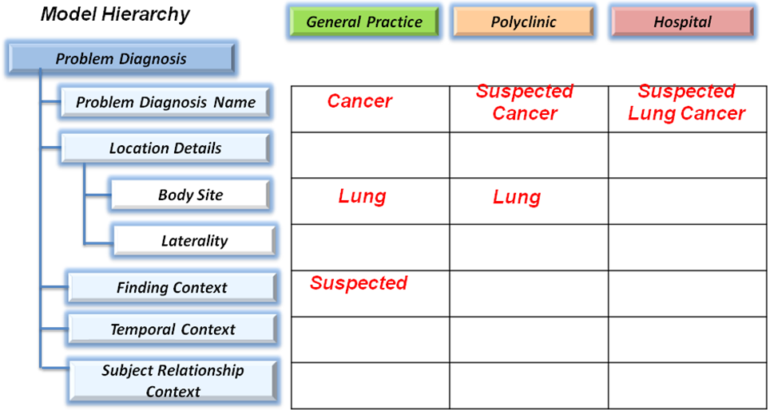
IsoSemantic Models – Example Instances
e.g. “Suspected Lung Cancer”

Slide 21
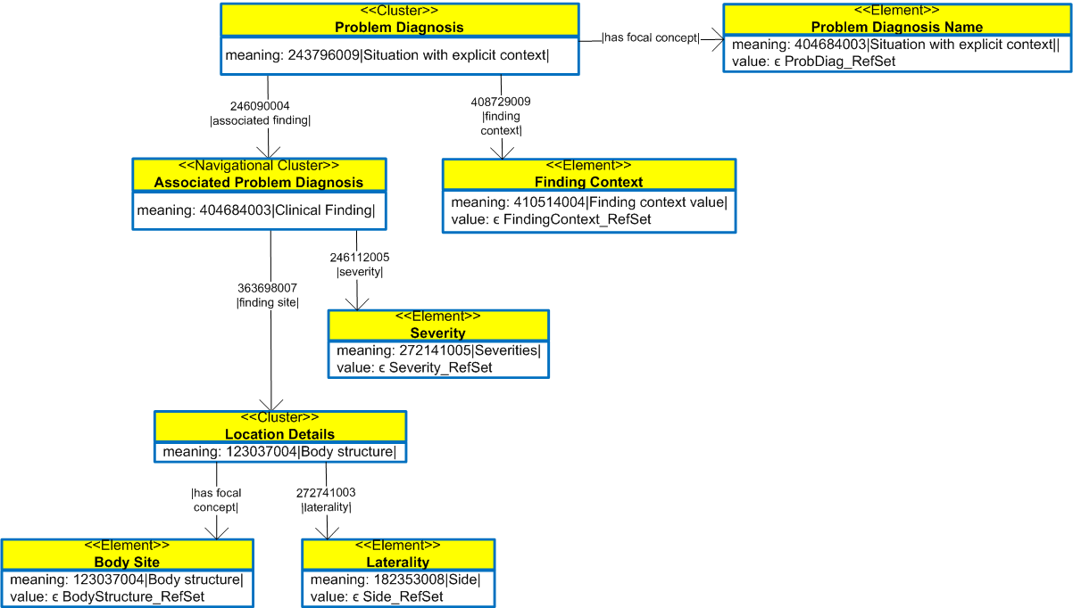
IsoSemantic Models – Compositional Grammar
Problem Diagnosis = $ProblemDiagnosisName:
246090004|associated_finding|=
(404684003|clinical_finding|:
63698007|finding_site|=($BodySite:
272741003|laterality|=$Laterality),
246112005|severity|=$Severity),
408729009|finding_context|=$FindingContext

Slide 22
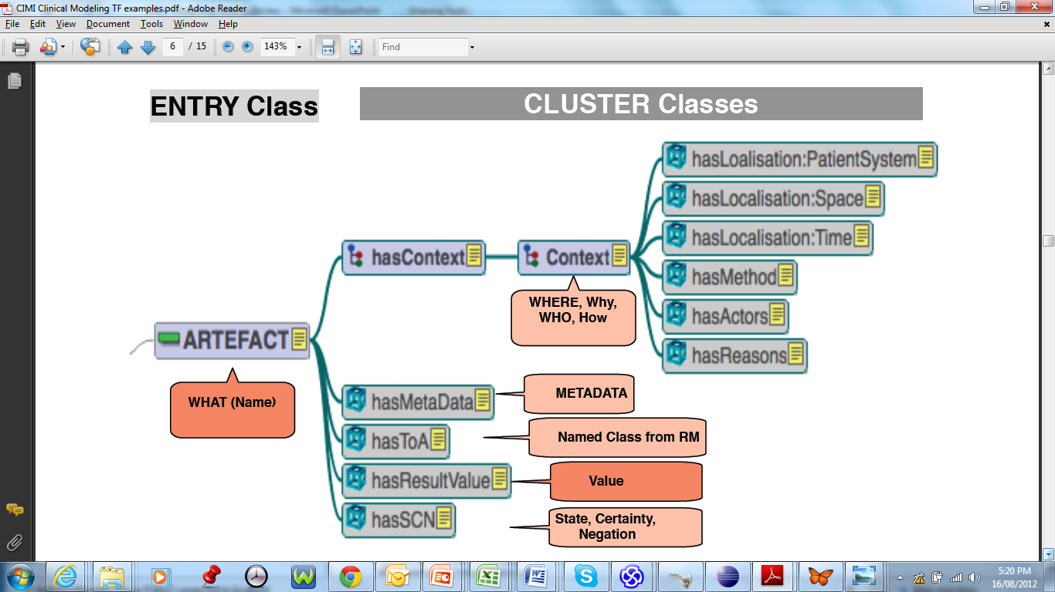
EN13606 Association

Slide 23
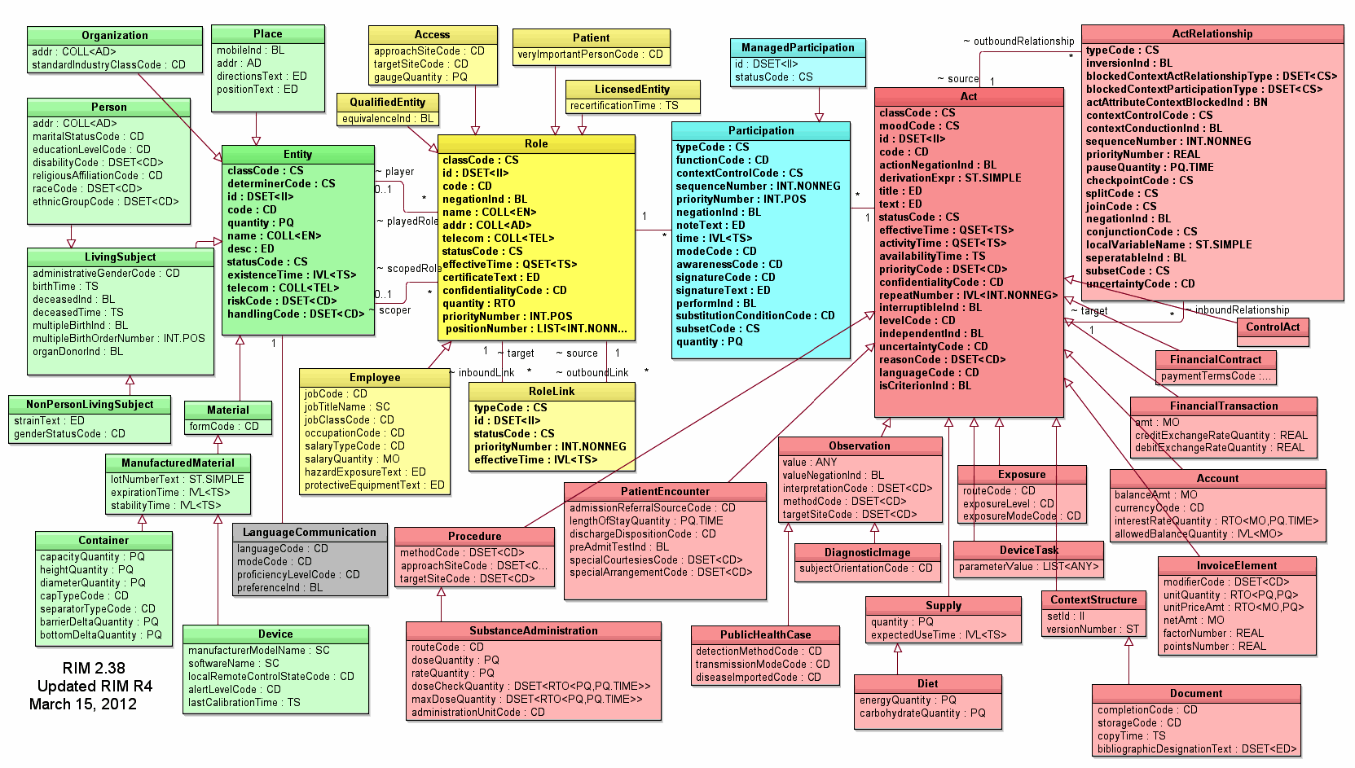
HL7 v3 RIM

Slide 24
Modelling Patterns Types
Clinical Statement Types
Isosemantic model structure
key concept, qualifiers, modifiers
Clinical processes events links
History of Events
Order state machine and care flow mapping
Composition/Document
Clinical Model Patterns
Reference Range Set, Schedule, Material (Device, Medication), Score/Assessment Scale
Clinical Statement Types
Isosemantic model structure
key concept, qualifiers, modifiers
Clinical processes events links
History of Events
Order state machine and care flow mapping
Composition/Document
Clinical Model Patterns
Reference Range Set, Schedule, Material (Device, Medication), Score/Assessment Scale

Slide 25
Clinical Statement Types
Reviewed
openEHR
Observation, Evaluation, Instruction, Action, Admin Entry
MOHH
Observation, Finding, Activity (Medication, Laboratory), Administration
NHS LRA
ELEMENTs: Property Observation, Finding Observation, Activity (Investigation, Material, General), Material Entity
ENTRYs: GenericFinding, GenericProcedure, GenericProblemAndIssue, ....
Intermountain/GE
Observed, StandardLabObs, Procedure, Order, Intolerance, Allergy, Adverse Reaction Summary, Admit/AdminDiagnosis, ...
SNOMED CT
Observable Entity, Clinical Finding, Procedure, ...
HL7 v3
Act (Observation, Procedure, Exposure, Patient Encounter, Financial Contract, Financial Transaction, Account, Invoice Element, Context Structure, Device, Task, Supply)

Slide 26
Clinical Statement Types
(Observation)
openEHR
Observation, Evaluation, Instruction, Action, Admin Entry
MOHH
Observation, Finding, Activity (Medication, Laboratory), Administration
NHS LRA
ELEMENTs: Property Observation, Finding Observation, Activity (Investigation, Material, General), Material Entity
ENTRYs: GenericFinding, GenericProcedure, GenericProblemAndIssue, ....
Intermountain/GE
Observed, StandardLabObs, Procedure, Order, Intolerance, Allergy, Adverse Reaction Summary, Admit/AdminDiagnosis, ...
SNOMED CT
Observable Entity, Clinical Finding, Procedure, ...
HL7 v3
Act (Observation, Procedure, Exposure, Patient Encounter, Financial Contract, Financial Transaction, Account, Invoice Element, Context Structure, Device, Task, Supply)

Slide 27
Clinical Statement Types
(Finding)
openEHR
Observation, Evaluation, Instruction, Action, Admin Entry
MOHH
Observation, Finding, Activity (Medication, Laboratory), Administration
NHS LRA
ELEMENTs: Property Observation, Finding Observation, Activity (Investigation, Material, General), Material Entity
ENTRYs: GenericFinding, GenericProcedure, GenericProblemAndIssue, ....
Intermountain/GE
Observed, StandardLabObs, Procedure, Order, Intolerance, Allergy, Adverse Reaction Summary, Admit/AdminDiagnosis, ...
SNOMED CT
Observable Entity, Clinical Finding, Procedure, ...
HL7 v3
Act (Observation, Procedure, Exposure, Patient Encounter, Financial Contract, Financial Transaction, Account, Invoice Element, Context Structure, Device, Task, Supply)

Slide 28
Clinical Statement Types
(Activity)
openEHR
Observation, Evaluation, Instruction, Action, Admin Entry
MOHH
Observation, Finding, Activity (Medication, Laboratory), Administration
NHS LRA
ELEMENTs: Property Observation, Finding Observation, Activity (Investigation, Material, General), Material Entity
ENTRYs: GenericFinding, GenericProcedure, GenericProblemAndIssue, ....
Intermountain/GE
Observed, StandardLabObs, Procedure, Order, Intolerance, Allergy, Adverse Reaction Summary, Admit/AdminDiagnosis, ...
SNOMED CT
Observable Entity, Clinical Finding, Procedure, ...
HL7 v3
Act (Observation, Procedure, Exposure, Patient Encounter, Financial Contract, Financial Transaction, Account, Invoice Element, Context Structure, Device, Task, Supply)

Slide 29
Clinical Statement Types
(Administration)
openEHR
Observation, Evaluation, Instruction, Action, Admin Entry
MOHH
Observation, Finding, Activity (Medication, Laboratory), Administration
NHS LRA
ELEMENTs: Property Observation, Finding Observation, Activity (Investigation, Material, General), Material Entity
ENTRYs: GenericFinding, GenericProcedure, GenericProblemAndIssue, ....
Intermountain/GE
Observed, StandardLabObs, Procedure, Order, Intolerance, Allergy, Adverse Reaction Summary, Admit/AdminDiagnosis, ...
SNOMED CT
Observable Entity, Clinical Finding, Procedure, ...
HL7 v3
Act (Observation, Procedure, Exposure, Patient Encounter, Financial Contract, Financial Transaction, Account, Invoice Element, Context Structure, Device, Task, Supply)

Slide 30
CIMI ENTRY Pattern Suggestions
Property Observation (property-value pair)
Clinical Finding (name)
Activity (orders, procedures, etc)
Administration (X ?)

Slide 31
Property Observation
(Existing Definitions)
openEHR
Observation: the observation of any phenomenon or state of interest to do with the patient (eg diagnosis, goal, adverse reaction).
NHS LRA
Property Observation: Used to represent the results of investigations undertaken to find out more information about a patient's state of health or wellbeing and device or procedure related parameter settings. (Meaning-value pairs)
SNOMED CT
Observable Entity: represents a question or procedure which can produce an answer or a result. Used to code elements on a checklist or any element where a value
EN13606 Association
Observation/Inspection: Used to define all that can be documented about a specific state of a process in the Patient System at a point in time using the faculties of seeing, hearing, tasting, touching, smelling, or directly via a medical device or service.

Slide 32
Property Observation
(Suggested CIMI Definition)
Used to represent the results of observations or investigations undertaken to find out more information about a patient’s state of health or wellbeing, and device or procedure related settings.
Comments:
E.g. Heart rate, Blood glucose, Glasgow Coma Scale
Represents the common name-value or question-answer pattern
Supports isosemantic representation of Observation Names that may include method, patient_state, device, location and other related information in pre or post-coordinated form.

Slide 33
Clinical Finding
(Existing Definitions)
openEHR
Evaluation: the Opinion category , including problem/diagnosis, risk assessment, scenario, goal and recommendation
NHS LRA
Finding Observation: used to represent both normal and abnormal clinical states found on examination or deduced from clinical reasoning (e.g. 'clear sputum', 'diabetes mellitus') and events to which the patient or service user may have been to subject (e.g. 'physical abuse', 'exposure to mercury').
SNOMED CT
Clinical Finding: represent the result of a clinical observation, assessment or judgement, and include both normal and abnormal clinical states
EN13606 Association
Evaluation/Consideration: Used for the documentation about an inferred process in the patient system using observations, expertise and knowledge, or about plans with, or risk assessments about, the Patient system

Slide 34
Clinical Finding
(Suggested CIMI Definition)
Used to represent clinical states found on examination or deduced from clinical reasoning (e.g. ‘diabetes mellitus’, ‘clear sputum’), and events to which the patient may have been subject (e.g. ‘physical abuse’, ‘exposure to mercury’).
Comments:
E.g. Diagnosis, Adverse Reaction, Alert
Supports isosemantic representation of Clinical Finding Names that may include body location, laterality, causative agent and other related information in pre or post-coordinated form.

Slide 35
Activity
(Existing Definitions)
openEHR
Action: Information recorded due to the execution of an instruction by some agent
Instruction: Actions to be performed in the future.
NHS LRA
Activity: Used to record treatment procedures, investigation procedures, administrative procedures and the provision of advice and information to patients and carers
SNOMED CT
Procedure: Activities performed in the provision of health care
EN13606 Association
Instruction/Order: used to define all that can be documented about the intended actions with the aim to change the state or process in the Patient System
Action/Intervention: is used to define all that can be documented about events that changed (or could change) states or processes in the Patient System

Slide 36
Activity
(Suggested CIMI Definition)
Used to record activities that have been, are being, or are to be performed, including treatments, investigations, administrative procedures and the provision of advice or information.
Comments:
E.g. Medication Activity (Requested, Dispensed, Administered), Investigation Activity (Requested, Performed)
Supports isosemantic representation of Activity Names, which may include body location, priority, context and other related information in pre or post-coordinated form.

Slide 37
CIMI Modelling Patterns (Suggested Definitions)
Property Observation (property-value): Used to represent the results of observations or investigations undertaken to find out more information about a patient’s state of health or wellbeing, and device or procedure related settings.
E.g. Heart rate, Blood glucose, Glasgow Coma Scale
Clinical Finding (name): Used to represent clinical states found on examination or deduced from clinical reasoning (e.g. ‘diabetes mellitus’, ‘clear sputum’), and events to which the patient may have been subject (e.g. ‘physical abuse’, ‘exposure to mercury’).
E.g. Diagnosis, Adverse Reaction, Alert
Activity: Used to record activities that have been, are being, or are to be performed, including treatments, investigations, administrative procedures and the provision of advice or information.
E.g. Medication Activity (Requested, Dispensed, Administered), Investigation Activity (Requested, Performed)

Slide 38
CIMI Call For Clinical Models
Heart Rate - Property Observation
Body Mass Index – Property Observation
Apgar Score – Property Observation
Glucose Tolerance Test Result – Property Observation
Adverse Reaction – Clinical Finding
Medication order - Activity
Problem list – List (Section) of Clinical Finding (+ ?)
Care Giver Reported Nausea – Clinical Finding
Wound Culture Result – Activity + Property Observation?

Slide 39
LINKS between Models (Suggestions)
Property Observation to:
Finding: ‘has interpretation’
Activity: ‘results in’
Activity to:
Activity: ‘has instruction’, ‘depends on’, ‘must occur before’, etc
Clinical Finding: ‘has focus’, ‘results in’
Property Observation: ‘results in’
Clinical Finding to:
Property Observation: ‘reason for’
Activity: ‘finding method’, ‘is indication for’
Where to from here?
Review of Existing Approaches (e.g. NHS, ISO, SNOMED)
Proposal for CIMI

Slide 40
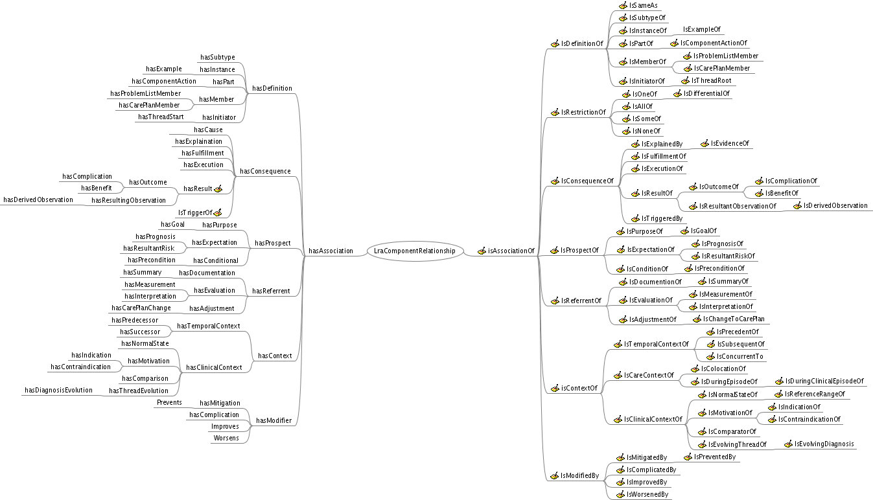
NHS LRA – Component Relationship Vocabulary (draft)

Slide 41
EN13606:3 Link Nature
Code | Meaning
LINK-A0 | is related to
LINK-B0 | is confirmed by
LINK-C0 | is related to the same problem or health issue
LINK-D0 | is related to the same plan of care, act or episode
LINK-E0 | is a related documentation

Slide 42
EN13606:3 Link Role
Code | Meaning
LINK-A1 | unspecified link
LINK-A2 | suggests (tentatively related to)
LINK-A2i | is suggested by
LINK-A3 | re-occurrence or repeat of
LINK-B1 | endorses (agrees with, confirms, verifies)
LINK-B2 | disagrees with (e.g. another opinion)
LINK-B3 | permits (sanctions, authorises)
LINK-B3i | permitted by
LINK-B4 | assumes responsibility for
LINK-B5 | declines (refuses, cancels)
LINK-B6 | consents to
LINK-B6i | consented by
LINK-C1 | cause (interpretation)
LINK-C1i | caused by
LINK-C2 | revised interpretation
LINK-C3 | evidence for
LINK-C3i | justified by
LINK-C4 | evidence against
LINK-C4i | countered by
LINK-C5 | indicated by
LINK-C5i | indication for
LINK-C6 | contra-indicated by
LINK-C6i | contra-indication for
Code | Meaning
LINK-C7 | trigger for
LINK-C7i | triggered by
LINK-C8 | manifestation of
LINK-C8i | manifested by
LINK-C9 | sequel (consequence, progression)
LINK-C10 | intended (aim, goal, target, hoped for, desired)
LINK-C11 | anticipated (predicted)
LINK-C12 | to be avoided (at risk of, fear of, prophylaxis)
LINK-D1 | outcome
LINK-D2 | has pre-condition
LINK-D3 | evaluation (assessment, milestone)
LINK-D4 | contributes to or fulfils goal, plan or act
LINK-D5 | revised state of the same act
LINK-D6 | sub-task of
LINK-E1 | documented by (is documented within)
LINK-E1i | documents (describes, reports)
LINK-E2 | summarises
LINK-E3 | supplements
LINK-E4 | excerpts
LINK-E5 | derived from
LINK-E6 | has reference ranges
LINK-E7 | identified within (study product)

Slide 43
SNOMED CT
OBSERVABLE ENTITY
CLINICAL FINDING
Finding method: PROCEDURE
Interprets: PROCEDURE
Interprets: OBSERVABLE ENTITY
PROCEDURE
Has focus: CLINICAL FINDING
... And many other ‘Linkage’ concepts

Slide 44
SNOMED CT Concept Model
Clinical Finding
Finding site <<442083009|Anatomical or acquired body structure|
Associated morphology << 4975500|Morphologically abnormal structure|
Associated with <<404684003|Clinical Finding|, 71388002|Procedure|, 272379006|Event|, 410607006|Organism|, 105590001|Substance|, 260787004|Physical object|, 78621006|Physical force|, 373873005 |Pharmaceutical / biologic product|
Severity <= 272141005 |Severities|
Clinical course <= 288524001|Courses|
Episodicity <= 288526004|Episodicities|
Interprets << 363787002|Observable entity|, 108252007|Laboratory procedure|, 386053000|Evaluation procedure|
Has interpretation << 260245000|Findings values|
Pathological process == 263680009|Autoimmune|, <<441862004|Infectious process|
Has definitional manifestation << 404684003|Clinical finding|
Occurrence < 282032007|Periods of life|
Finding method <= 71388002|Procedure|
Finding informer <<420158005|Performer of method|, 419358007|Subject of record or other provider of history|

Slide 45
SNOMED CT Concept Model
Procedure
Procedure site << 442083009|Anatomical or acquired body structure|
Procedure morphology <<49755003|Morphologically abnormal structure|
Method <<129264002|Action|
Procedure device <<49062001|Device|
Access <=309795001|Surgical access values|
Direct Substance <<105590001|Substance|, 37387305|Pharmaceutical / biologic product|
Priority <=272125009|Priorities|
Has focus <<404684003|Clinical finding|, 71388002|Procedure|
Has intent <=363675004|Intents (nature of procedure values)|
Recipient category <<125676002|Person|, 35359004|Family|, 133928008|Community|, 105455006|Donor for medical or surgical procedure|, 389109008|Group|
Revision status <<261424001|Primary operation|, 255231005|Revision - value|, 257958009|Part of multistage procedure|
Route of administration <<284009009|Route of administration value|
Surgical approach <=103379005|Procedural approach|
Using energy <<78621006|Physical force|
Using substance <<105590001|Substance|

Slide 46
LINKS between Models (Suggestions)
Property Observation to:
Finding: ‘has interpretation’
Activity: ‘results in’
Activity to:
Activity: ‘has instruction’, ‘depends on’, ‘must occur before’, etc
Clinical Finding: ‘has focus’, ‘results in’
Property Observation: ‘results in’
Clinical Finding to:
Property Observation: ‘reason for’
Activity: ‘finding method’, ‘is indication for’
Where to from here?
Review of Existing Approaches (e.g. NHS, ISO, SNOMED)
Proposal for CIMI

Slide 47
CIMI Modelling Pattern Attributes
(Suggestion)
All
Participations: subject, information provider
Elements: Timing
Elements: Clinical Status
Property Observation
Participations: observer
Cluster (Isosemantic ): Property (name, descriptors)
Cluster: Result (name, value, details, interpretation, reference range)
Links: observing activity, interpretation, is indication of, other
Finding
Participations: finder
Cluster (Isosemantic ): Finding Item (name, descriptors)
Cluster: Finding Details (details)
Links: finding method, finding procedure, is indication of
Activity
Participations: performer
Cluster (Isosemantic): Activity Item (name, descriptors)
Element: Activity Identifier(s)
Cluster: Activity Details (details)
Links: has instruction, depends on, must occur before

Slide 48
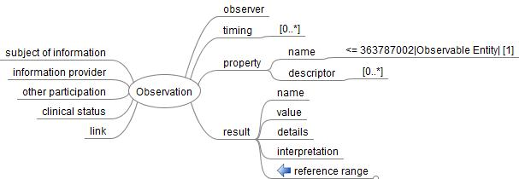
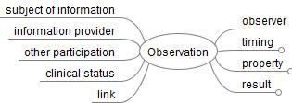
Property Observation

Slide 49
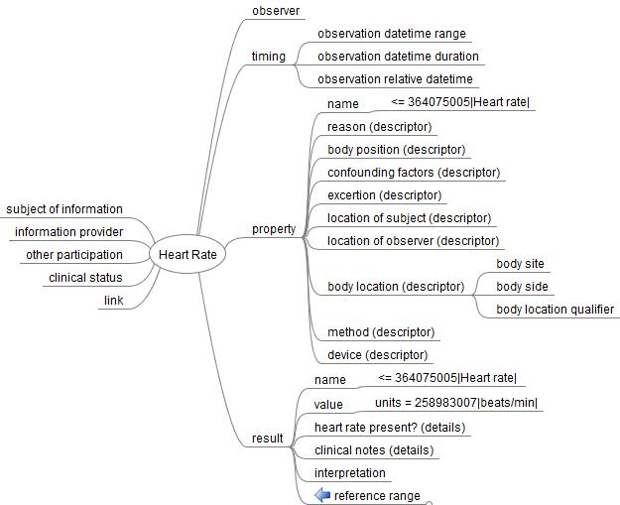
Heart Rate Example

Slide 50
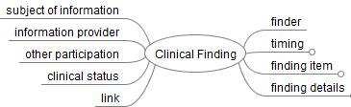
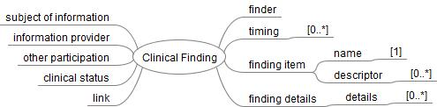
Clinical Finding

Slide 51
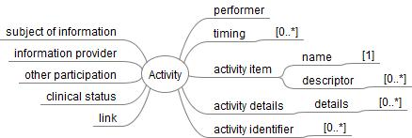
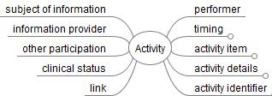
Activity

